Slide 1

Zühlke Tech 4 Good: Sprint
Tech Returners, Team CodeBenders
March’21 Cohort
Ciaran Cullen, Marius Grigore, Susan Luebke, Sriranjini Srinivasa
April 1, 2021

Slide 2

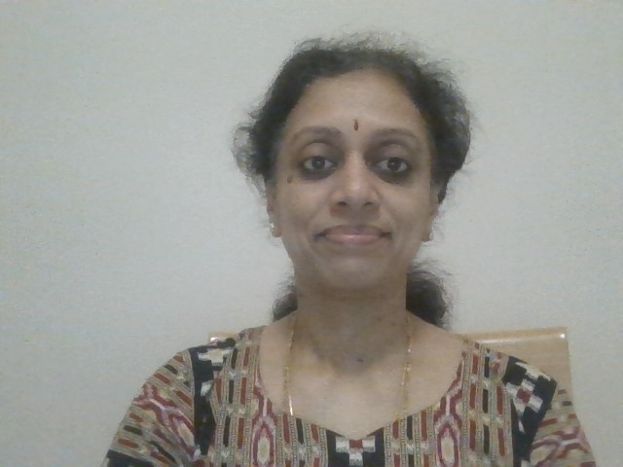
Sriranjini Srinivasa Masters Degree in Computer Applications Around 7 years of work experience as a Techno-Functional Consultant for ERP and RDBMS Fair knowledge of Asp.Net, C#, Java Worked with clients like Woolworths, Acer, Eaton Always open to learn new technologies

Slide 3
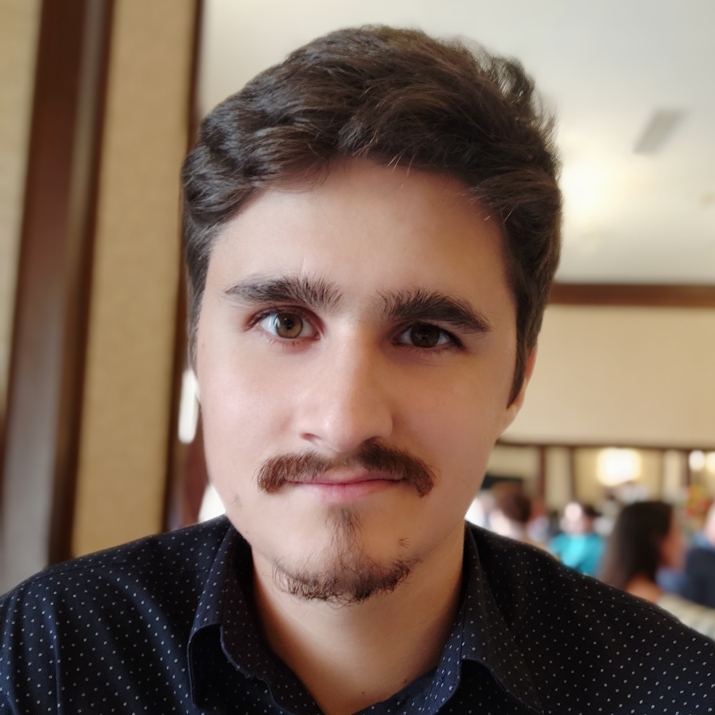
Marius Grigore BSc in Computer Science 4 years of commercial technical experience - Created internal automation tools (Python, Java, Matlab, VB) - Offered technical and process support for a team of 20 people - Worked on engine control projects for Renault and Nissan I have a real interest in everything related to technology

Slide 4
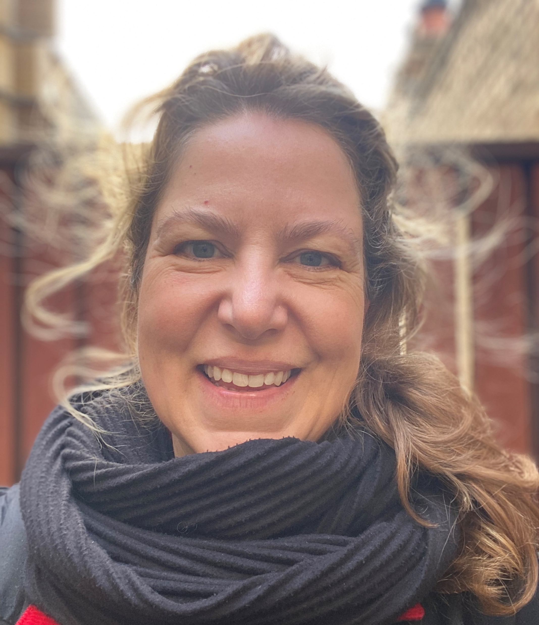
Susan Luebke Hello – my name is Susan. I have an MSW, MBA and 15 years’ experience as an innovative consumer Insights and brand marketing professional with project, agency and stakeholder management expertise with LG, Bacardi, Grace Kennedy, BP and LucasArts, to name a few Experience with Python, SQL, PowerBI and Tableau and I’ve received awards for product design COVID-19 provided me with an opportunity to upskill and pursue a career switch with a greater emphasis on solution-based programming; something I’ve been interested in doing since writing my first iPhone app several years ago

Slide 5

Ciaran Cullen Previous experience: 2 year accelerated BSc Games Programming course, 8 weeks of C#sdet training and a little work experience in a Telemarketer company Previous Projects: LDAP server syncing, Text based, 2D, 3D and VR games, Testing OpenWeatherMapAPI, Testing websites Tools/Libarys learned: for C++: SDL, SDL_net and Opengl using visual studio 2017 For C#: Unity, Nunit, SpecFlow and Selenium I have done very small projects using ASP.net, XAML and SQL servers. Self learning: Appium (mobile testing) Learning from Tec Returners: Java and JavaScript and much more!

Slide 6
Sunny Walk
Create a web app that can advise the user on the best times to take daily walks in order to maximise intake of sunshine.
Tech 4 Good

Slide 7
Create a web app that can advise the user on what the best times for them to take daily walks would be in order to maximise their intake of sunshine.
Persona – resident of Manchester/London or “walker”
FEATURES | STRETCH FEATURES | STRETCH FEATURES: DIFFERENT TYPES OF USERS | TECHNICAL
During what times I can get the most sunshine based on my location, current time and the weather forecast so I that I can plan my walk into my day and optimize my sunshine intake | Log the area where I walked so that I can track my walks on the map | Walker, customize my user profile so that I can receive relevant advice about/during my walks (e.g. I don’t like rain, so I would like to be advised if I should take an umbrella with me) | Responsive web design
Receive a notification some time before my walk so that I don’t miss it | My preferred locations so that I can plan to enjoy the sunshine in places that I usually frequent or I am about to travel to | Wheelchair user, I want to know about the walks that are accessible (wheelchair friendly) so that I can enjoy the sunshine without worries or assistance | Progressive web app
Log if a walk was good or bad so that I can track my satisfaction with the walks over time | Set up my preferred weather conditions so that I can enjoy my favourite weather during my walks. (e.g. I prefer cloudy weather; I prefer taking walks in the rain) | Dog walker, I want to know routes with dog-friendly areas nearby so that my dog can socialise with other dogs | Accessibility considerations
 |  | Parent, I want to know about routes that have parks with playgrounds nearby so that I can enjoy a walk without my children getting bored. | Possibility of using data from gov.uk (or something else), being Manchester
 |  | Roller skater, I want to know where the safest routes for roller skating are so that I can enjoy my hobby without needing replacement wheels after every outing or injuring myself
 |  | Walker, I want to leave comments about the area where I had a walk so that I can make other users aware about different area features. (e.g. water fountains, dog waste bins, etc.)

Slide 8
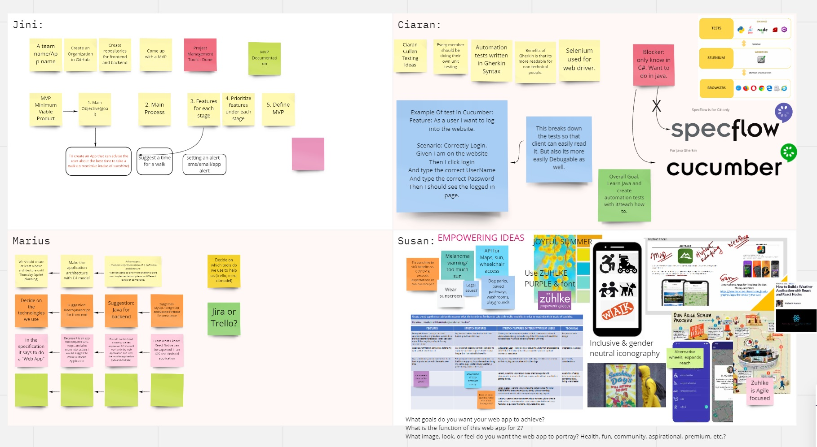

Slide 9
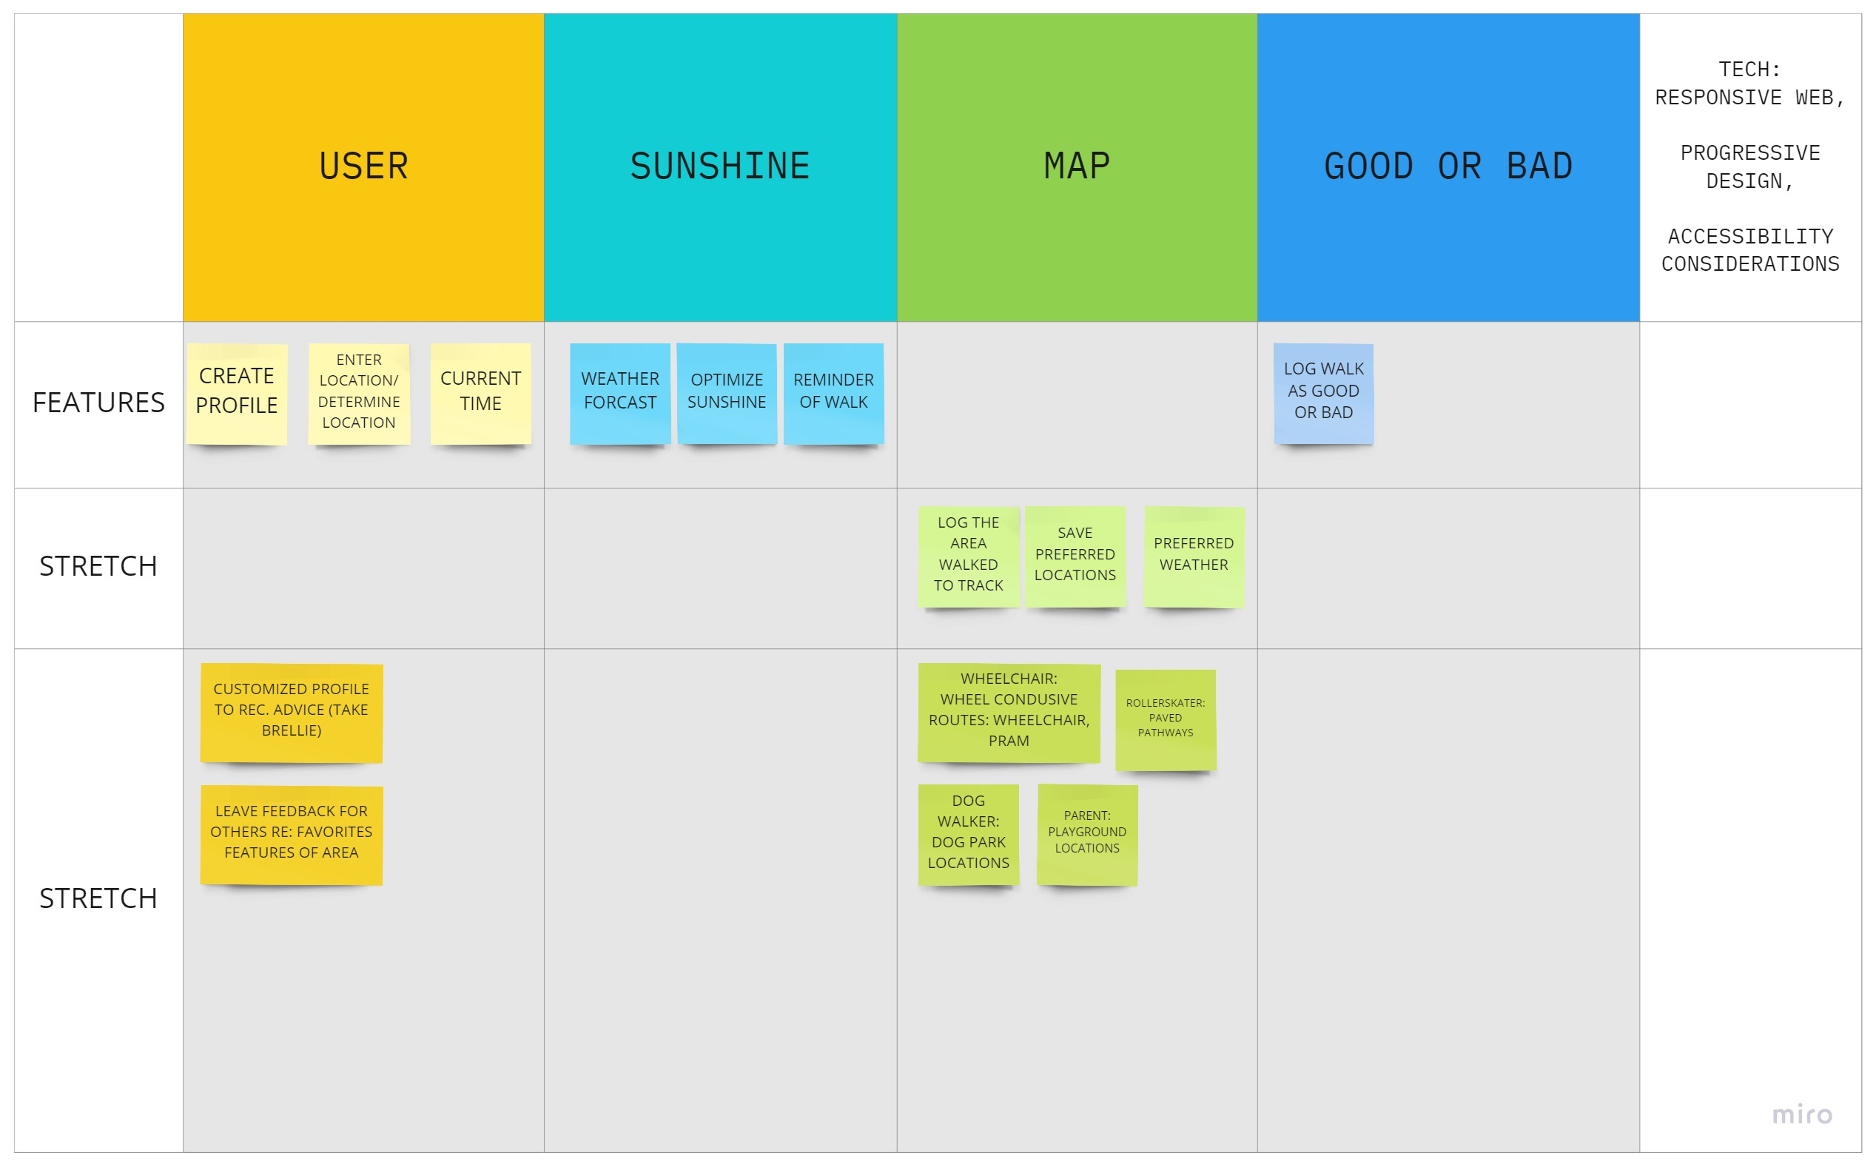
Minimum Viable Product (MVP)

Slide 10
Agile Summary
Scrum Stand Ups 3x week
Reflection 1x week (Friday)
Scrum Leader rotates weekly
Pair programming weekly
Within team and out
GitHub: Team member reviews and merge
Tools: Trello, Miro, Google Calendar

Slide 11
Main Page

Slide 12
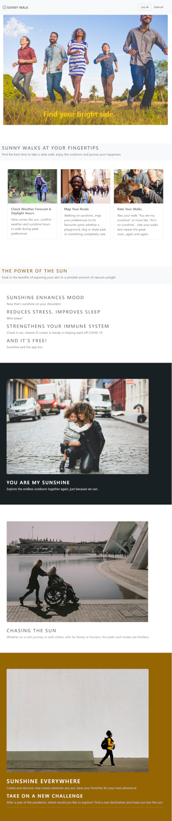
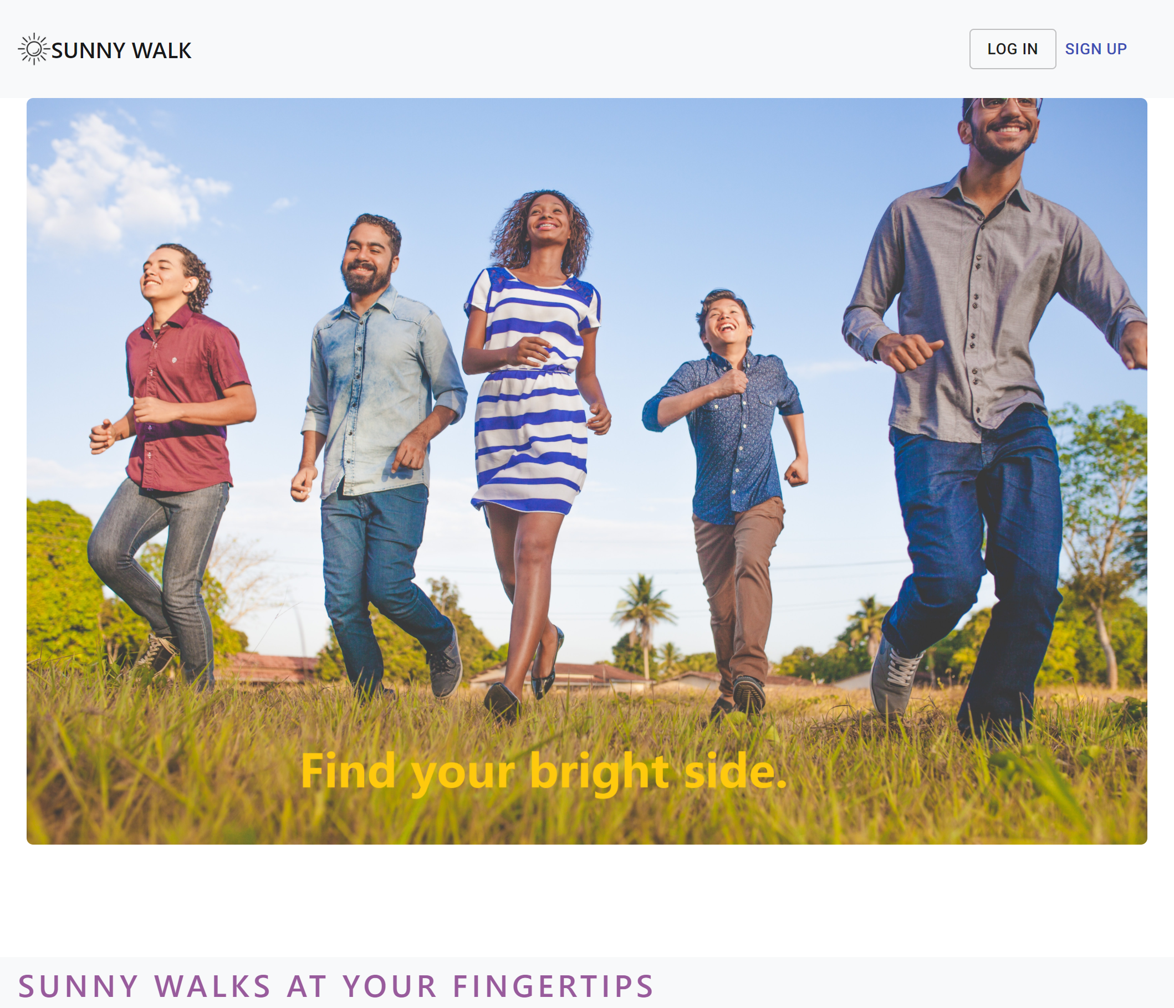
Main Landing Page Interface
Upbeat, modern design
Strong multicultural and multigenerational visuals
Fully responsive design
Readable typography
Zühlke “purple” accents
Standardized & inclusive code
Dwell time maximizer with 11 sunshine song inclusions
Potential for environmental pay it forward element with song click through

Slide 13
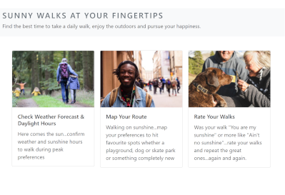
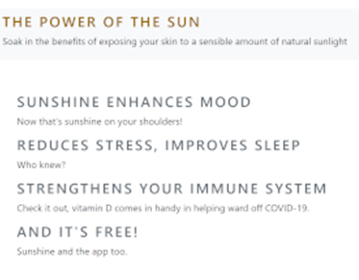
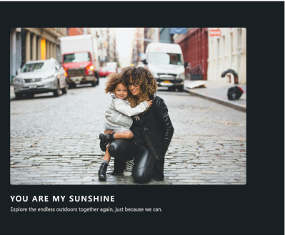
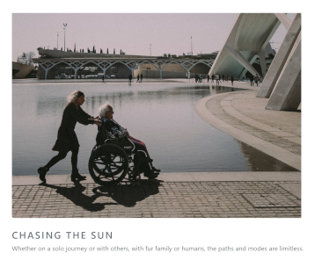
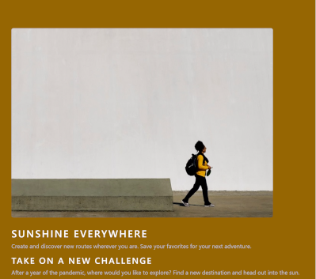
Sunny Walk Main Landing Page

Slide 14
User Home Page

Slide 15
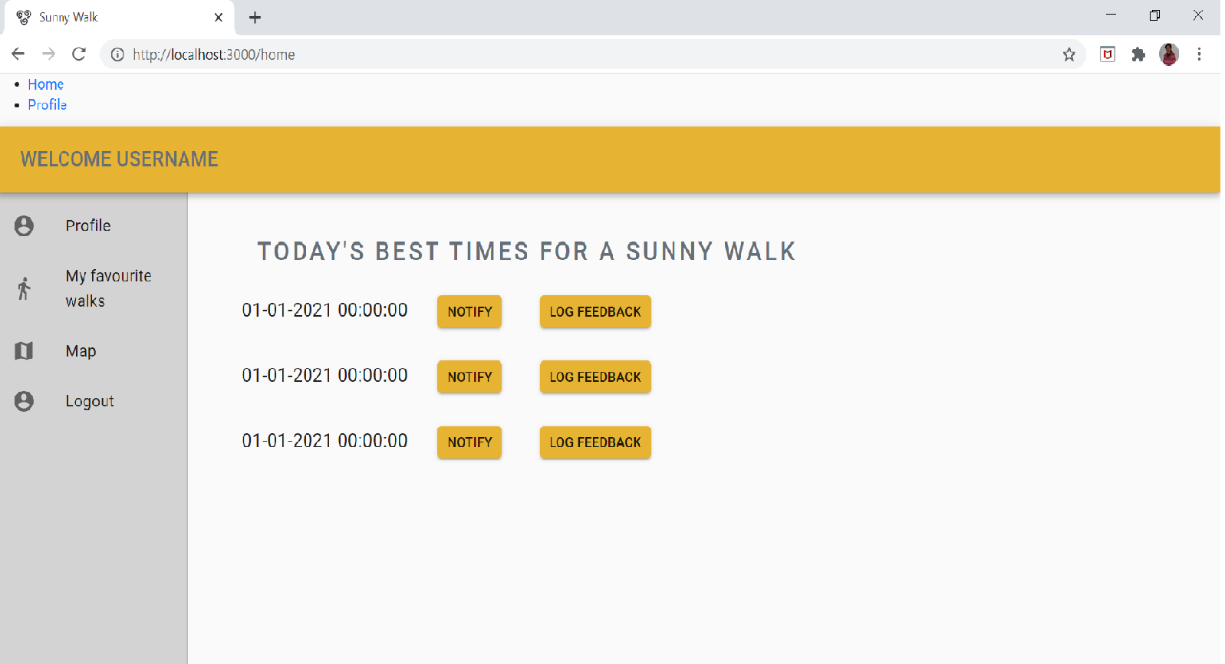
User Home Page Interface
Displays:
Current day’s 3 best suitable times to take a walk
Notify the user via email/browser notification
Allow user to log a feedback about a particular walk
Option to view/modify Profile page
Link to view user’s favourite walks

Slide 16
Profile Page

Slide 17
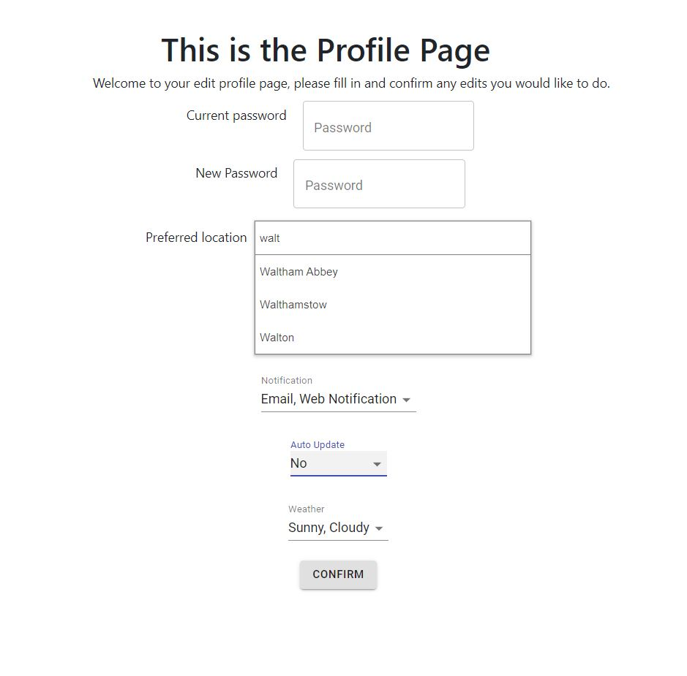
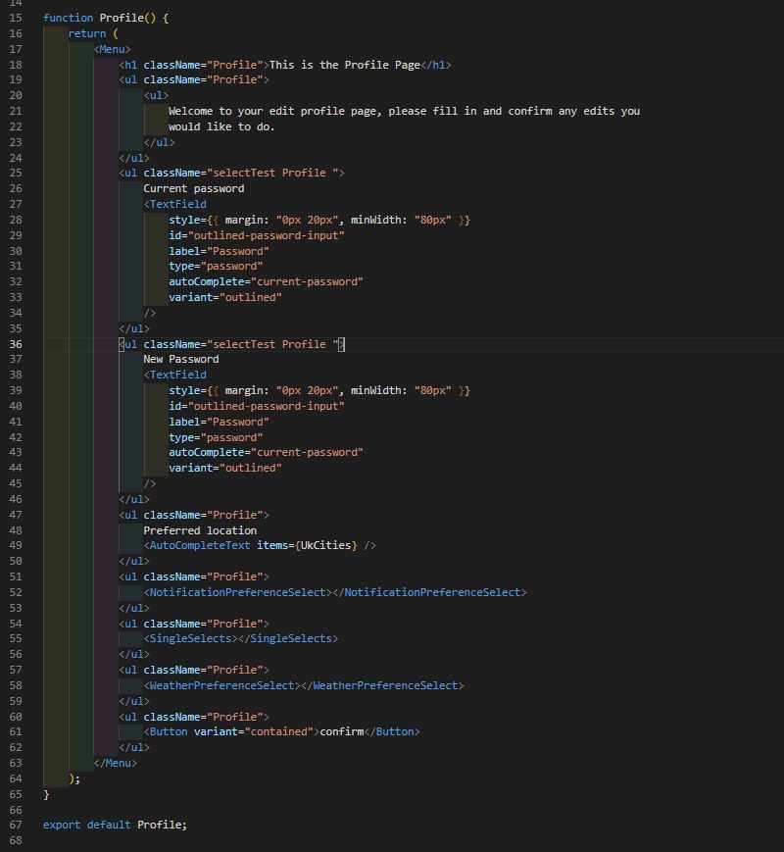
Profile Page Interface
KISS principle
Profile Editing page
Uses Material UI to create the password and select elements
Preferred Location fully coded
User can select multiple for notification and weather

Slide 18
Login & Registration Page

Slide 19
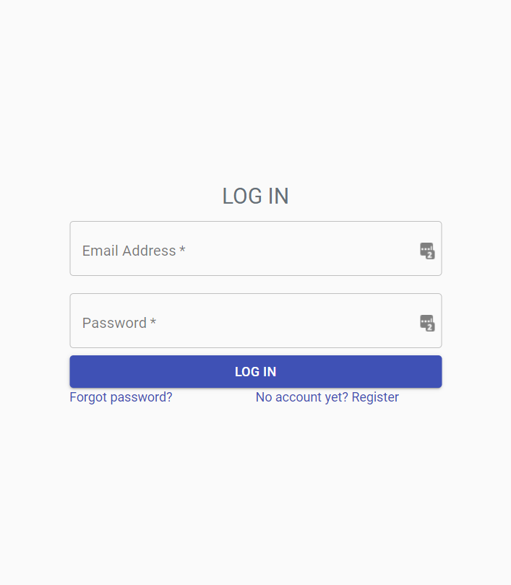
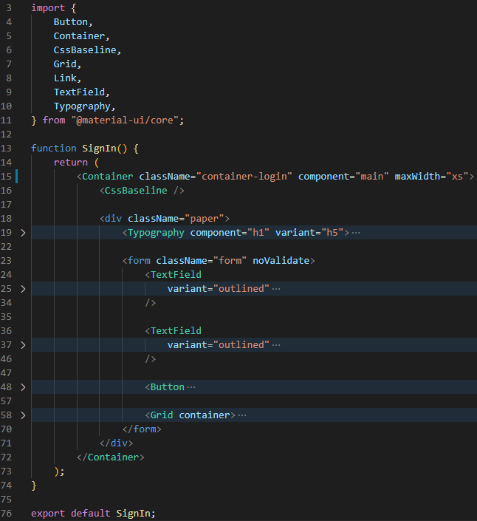
Login Page Interface

Slide 20
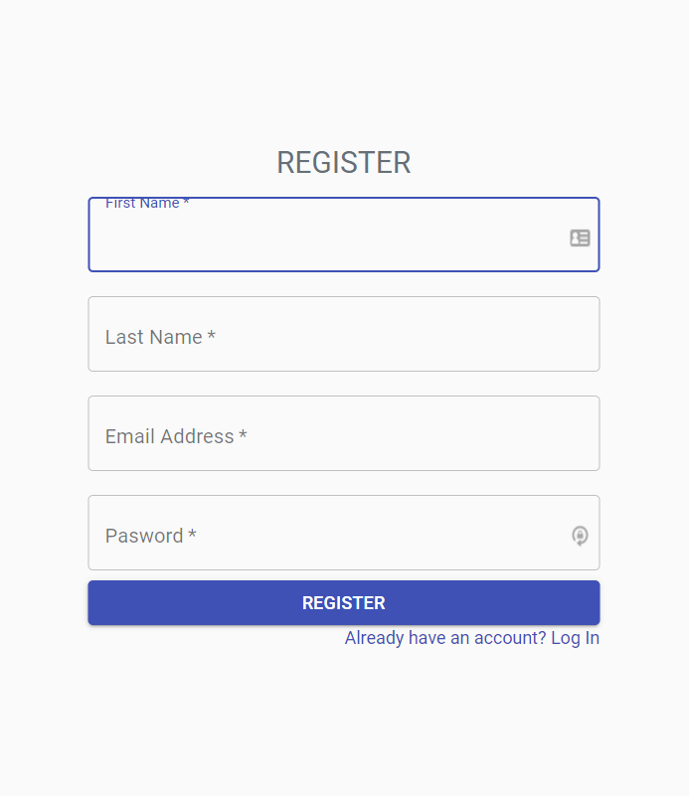
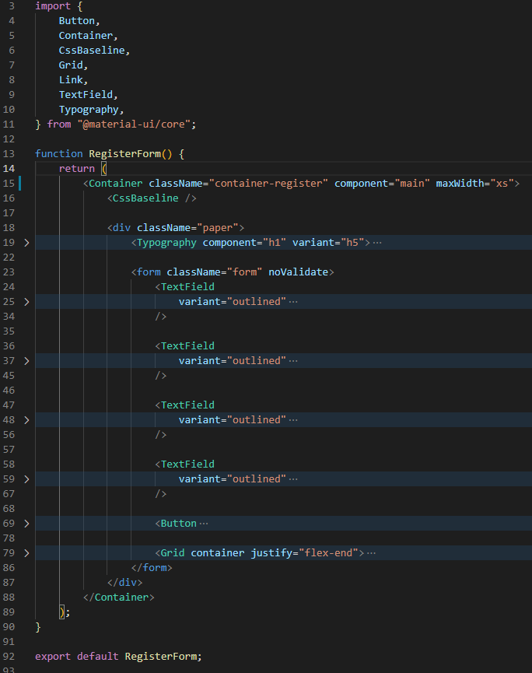
Registration Page Interface

Slide 21
Discussion
Thank you

Slide 22
Backend Preparations
Tools: MySQL & Java
Preliminary setup
Next steps: test and fix bugs

Slide 23
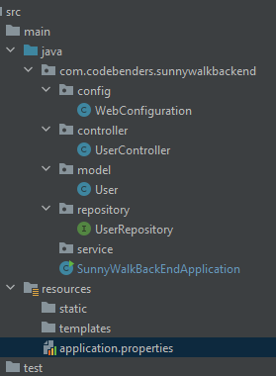
Backend Structure

Slide 24
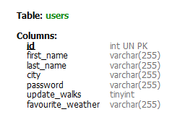
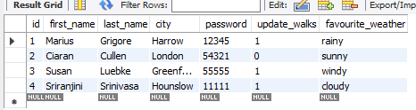
User Data

Slide 25
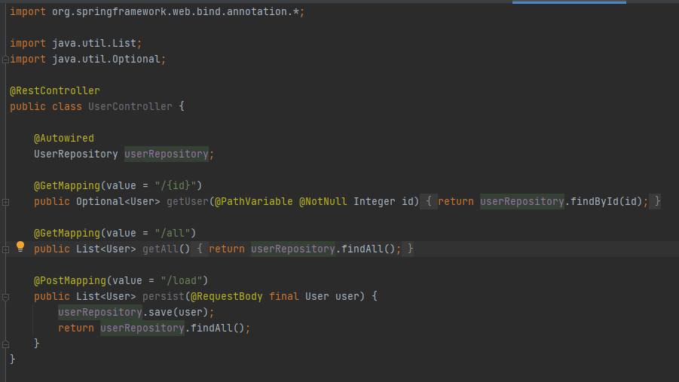
Backend Controller

Slide 26
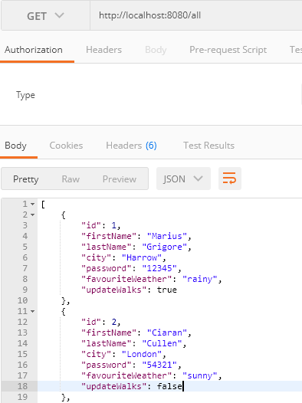
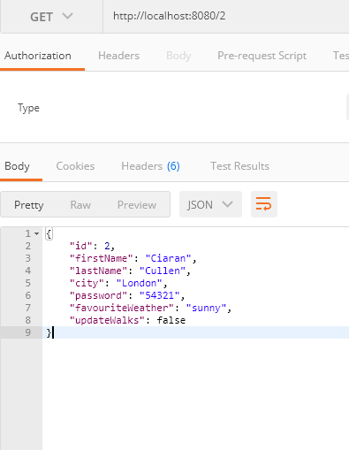
Backend API - Postman test

